Slide 1
MIS 7720 #10 Convolutional Neural Networks (CNN)

Slide 2
Performance vs Sample Size
Deep Learning algorithms
Performance
Traditional ML algorithms
Size of Data

Slide 3
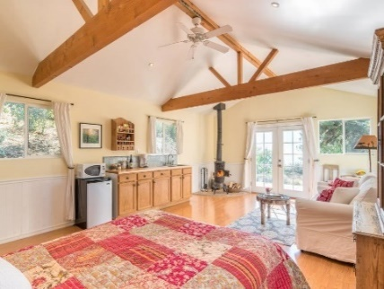
Supervised Learning
Traditional pattern recognition models work with hand crafted features and relatively simple trainable classifiers.
Limitations
Very tedious and costly to develop hand crafted features.
The hand-crafted features are usually highly dependents on one application.
Trainable Classifier
(e.g. SVM, Random Forrest)
Extract Hand Crafted Features
Output
(e.g. Outdoor Yes or No)

Slide 4


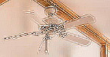
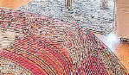
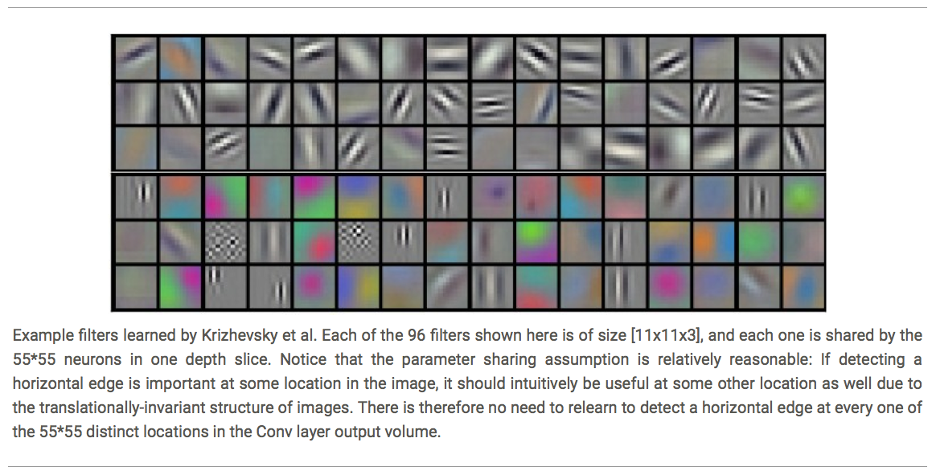
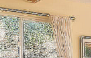
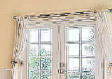


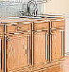
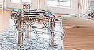



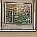

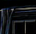

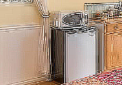
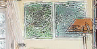
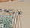
Deep Learning
Deep learning has an inbuilt automatic multi-stage feature learning process that learns rich hierarchical representations (i.e. features).
Low Level Features
Mid Level Features
High Level Features
Trainable Classifier
Output
(e.g. outdoor, indoor)

Slide 5
Deep Learning
Input
Low Level Features
Mid Level Features
High Level Features
Trainable Classifier
Output
Image
Pixel Edge Texture Motif Part Object
Text
Character Word Word-group Clause Sentence Story
Each module in Deep Learning transforms its input representation into a higher-level one, in a way similar to human cortex.

Slide 6
Neural Networks review
See the first 3 videos in the playlist for a good review on the following topics we discussed:
Neural networks
Gradient Descent
Backpropagation
https://www.youtube.com/playlist?list=PLZHQObOWTQDNU6R1_67000Dx_ZCJB-3pi

Slide 7
A Simple Neural Network
An Artificial Neural Network is inspired by the biological nervous systems, such as the human brain’s information processing mechanism.
x1
a1⁽¹⁾
x2
a2⁽¹⁾
a1⁽²⁾
Y
x3
a3⁽¹⁾
x4
a4⁽¹⁾
Input
Hidden Layers
Output

Slide 8
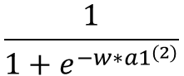
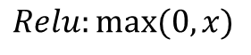
A Simple Neural Network
Sigmoid or Softmax
w1
$$\frac{1}{1+e^{−w{∗a1}^{(2)}}}$$
x1
x1
a1⁽¹⁾
a1⁽¹⁾
w2
x2
x2
a2⁽¹⁾
w3
Y
a1⁽²⁾
x3
x3
a3⁽¹⁾
w4
x4
x4
a4⁽¹⁾
$${a1}^{(1)}=f\left(w1∗x1+w2∗x2+w3∗x3+w4∗x4\right)$$
f( ) is activation function: Relu or sigmoid
$$Relu:max⁡(0,x)$$
$${a1}^{(1)}=max\left(0, w1∗x1+w2∗x2+w3∗x3+w4∗x4\right)$$

Slide 9
Number of Parameters
Softmax (or Sigmoid)
x1
a1⁽¹⁾
x2
a2⁽¹⁾
a1⁽²⁾
Y
x3
a3⁽¹⁾
x4
a4⁽¹⁾
Input
Hidden Layers
Output
4*4 + 4
+4+1

Slide 10
What if the input is an Image?
x1
a1⁽¹⁾
x2
a2⁽¹⁾
a1⁽²⁾
Y
x3
a3⁽¹⁾
400 X 400 X 3
a480000⁽¹⁾
x480000
Input
Hidden Layers
Output
Number of Parameters
480000*480000 + 480000 +1 = approximately 230 Billion !!!
480000*1000 + 1000 +1 = approximately 480 million !!!
Notes:
Convolutional layers can help!!

Slide 11
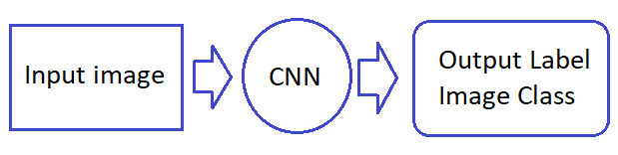
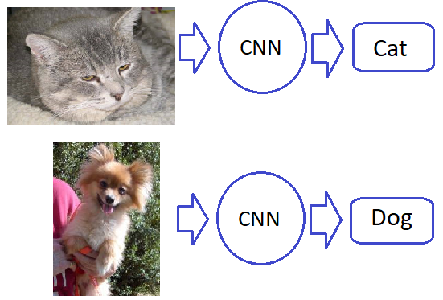
Convolutional Neural Network (CNN)
Notes:
Read this article alongside the slides
https://towardsdatascience.com/a-comprehensive-guide-to-convolutional-neural-networks-the-eli5-way-3bd2b1164a53

Slide 12
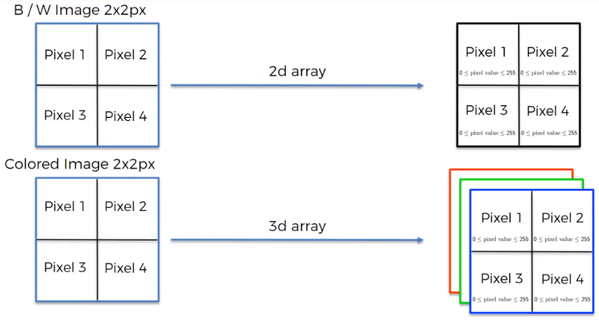
Processing image
Notes:
Grayscale, B/W needs one channel
Colored image (RGB) needs 3 channels

Slide 13
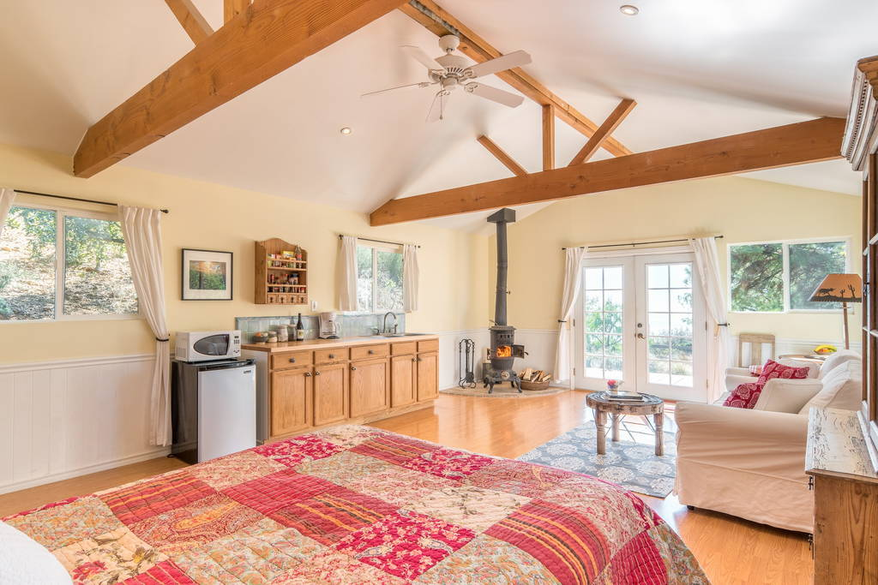
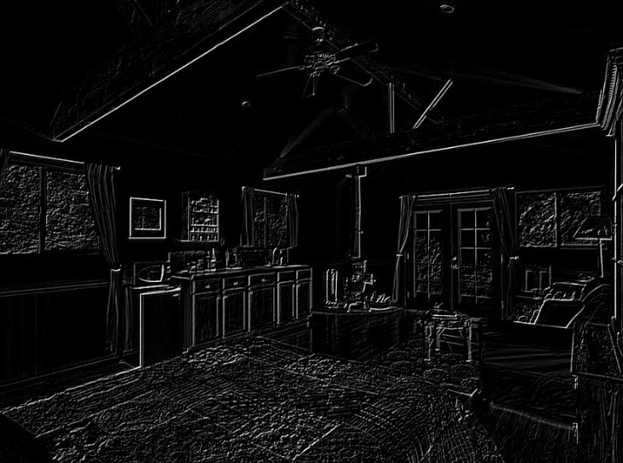
Convolutional Layers – step1
0 1 0
1 -4 1
0 1 0
Filter
Input Image
Convoluted Image
Inspired by the neurophysiological experiments conducted by Hubel and Wiesel 1962.
Notes:
https://www.ncbi.nlm.nih.gov/pmc/articles/PMC1359523/
Demo: gimp conv matrix filter
filter → generic → Convolution Matrix
Online interactive demo: https://setosa.io/ev/image-kernels/

Slide 14
Convolutional Layers
What is Convolution?
$$h1=f\left(a∗w1+b∗w2+e∗w3+f∗w4\right)$$
a | b | c | d
e | f | g | h
i | j | k | l
m | n | o | p
w1 | w2
w3 | w4
h1 | h2
Input Image
Filter
Convolved Image
(Feature Map)
$$h2=f\left(b∗w1+c∗w2+f∗w3+g∗w4\right)$$
Number of Parameters for one feature map = 4
Number of Parameters for 100 feature map = 4*100
Notes:
Convolution: is a math operation combining to functions into
Matrix Convolution is the treatment of a matrix (here, our image pixels) by a mask/filter (called “kernel”).
Demo: gimp conv matrix filter
filter → generic → Convolution Matrix
https://docs.gimp.org/2.8/en/plug-in-convmatrix.html

Slide 15


Different filter sizes and strides
3X3 filter with stride of 2
5x5 filter with stride of 1
Notes:
https://setosa.io/ev/image-kernels/

Slide 16
From lower level to more complex features
w1 | w2
w3 | w4
w5 | w6
w7 | w8
Filter 1
Filter 2
Input Image
Layer 1 Feature Map
Layer 2 Feature Map
In Convolutional neural networks, hidden units are only connected to local receptive field.

Slide 17
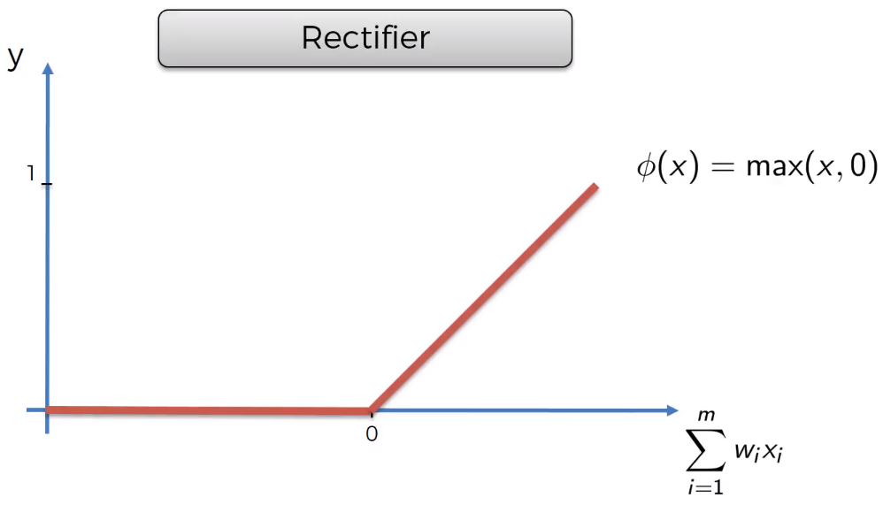
ReLU layer – step1(b)
ReLU activation function applied on convolutional layers
ReLu is a non-linear function to induce non-linearity
Image input is non-linear in nature and convolutional may create unwanted linearity

Slide 18
Pooling intuition – step2
What does pooling achieve (why pooling?)
Distinctive features are not always in the same exact location in an image
We want the NN to pick up features even if they are distorted
We want the NN to have spatial invariance

Slide 19
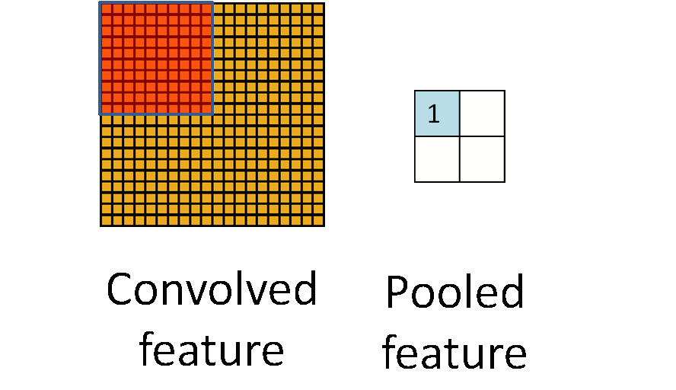
Pooling – step2
Max pooling: reports the maximum output within a rectangular neighborhood.
Average pooling: reports the average output of a rectangular neighborhood.
MaxPool with 2X2 filter with stride of 2
1 | 3 | 5 | 3
4 | 2 | 3 | 1
3 | 1 | 1 | 3
0 | 1 | 0 | 4
4 | 5
3 | 4
Input Matrix
Output Matrix

Slide 20

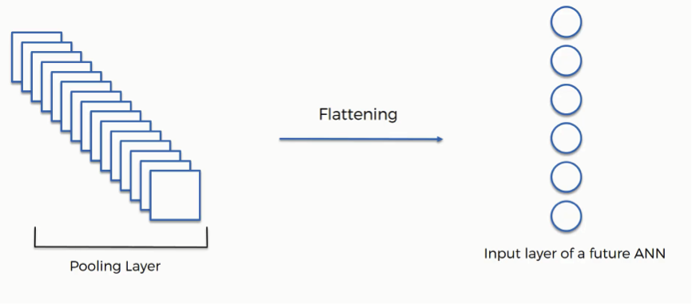
Flattening – step3
Provides the input for the Neural Network input layer:
long vector of input data

Slide 21
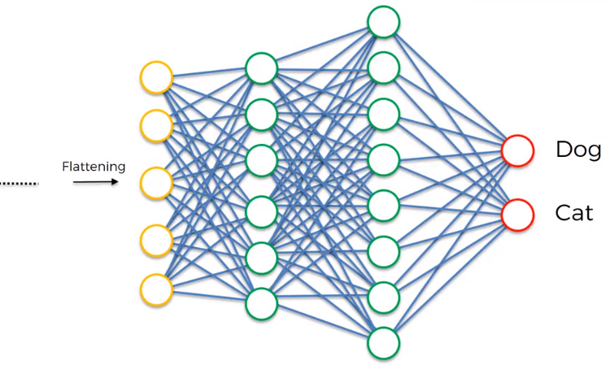
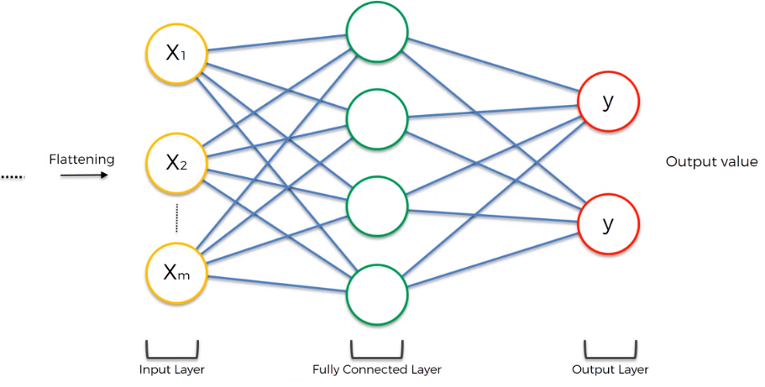
Full Connection – step4

Slide 22
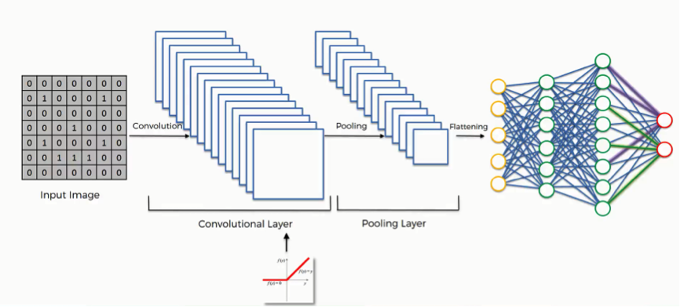
Overview of the process

Slide 23

CNN architecture

Slide 24

CNN architecture
Demo!
Notes:
Demo of a CNN to identify handwritten numbers (network trained on MNIST database):
http://www.cs.cmu.edu/~aharley/vis/conv/

Slide 25
Convolutional Neural Networks summary
Output: Binary, Multinomial, Continuous, Count
Input: fixed size, can use padding to make all images same size.
Architecture: Choice is ad hoc
requires experimentation.
Optimization: Backward propagation
hyper parameters for very deep model can be estimated properly only if you have billions of images.
Use an architecture and trained hyper parameters from other papers (Imagenet or Microsoft/Google APIs etc)
Computing Power: Multicore GPU!!

Slide 26
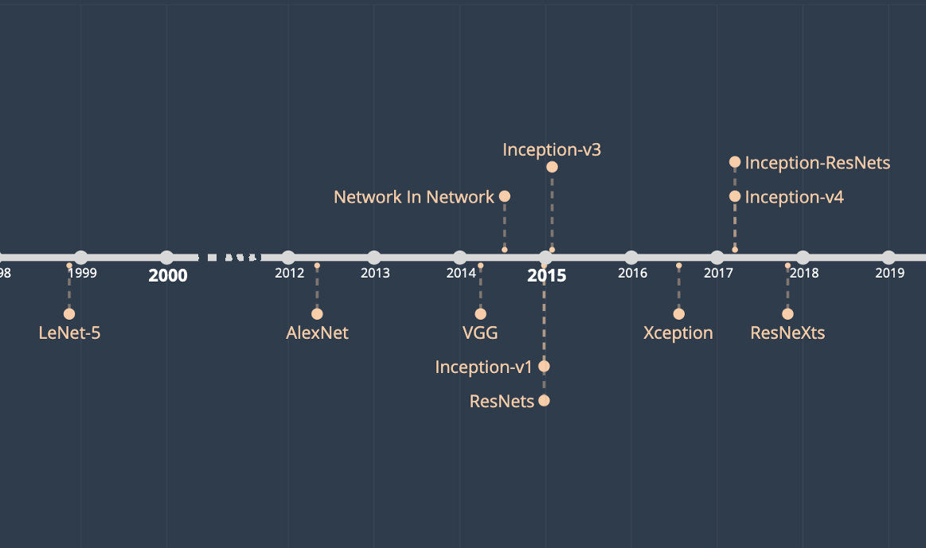
Other CNN architectures
We became familiar with the idea and basic architecture for CNNs. There have been several successful CNN architectures proposed in recent years, for example:
LeNet
AlexNet
VGGNet
GoogLeNet
ResNet
Notes:
https://towardsdatascience.com/illustrated-10-cnn-architectures-95d78ace614d#bca5
https://towardsdatascience.com/the-w3h-of-alexnet-vggnet-resnet-and-inception-7baaaecccc96
LeNet: http://yann.lecun.com/exdb/lenet/
AlexNet: https://papers.nips.cc/paper/2012/file/c399862d3b9d6b76c8436e924a68c45b-Paper.pdf
VGGNet: https://arxiv.org/abs/1409.1556
GoogLeNet: https://arxiv.org/abs/1409.4842
ResNet: https://arxiv.org/abs/1512.03385
ZFNet: https://arxiv.org/abs/1311.2901v3

Slide 27
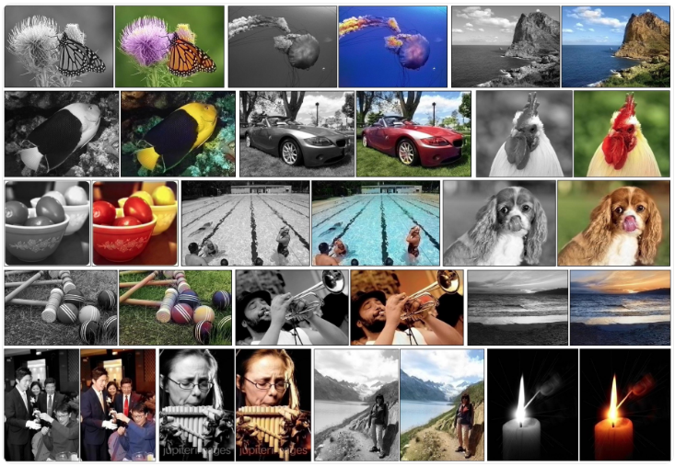
Application: Automatic Colorization of Black and White Images

Slide 28
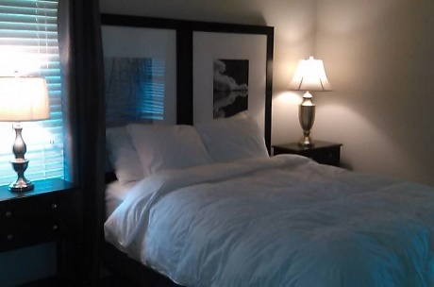
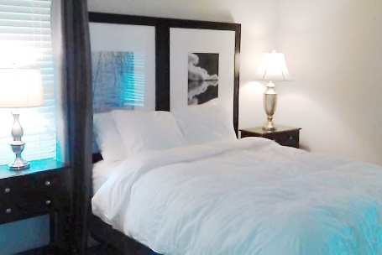
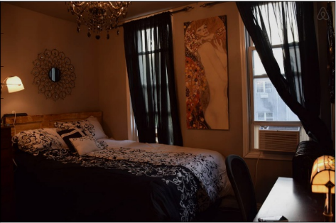
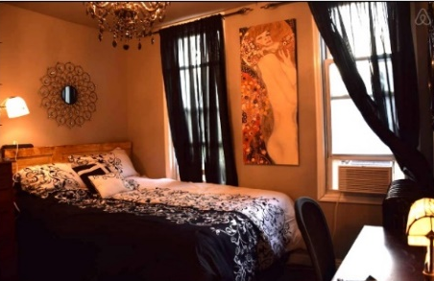
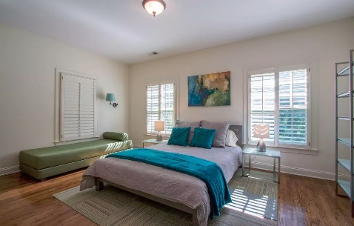
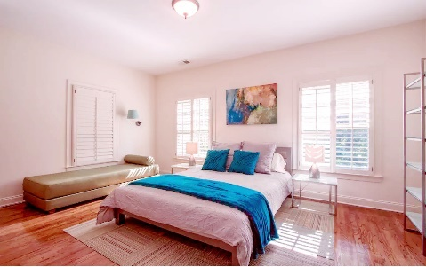
Application: Optimizing Images
Post Processing Feature Optimization (Color Curves and Details)
Post Processing Feature Optimization (Illumination)
Post Processing Feature Optimization (Color Tone: Warmness)

Slide 29
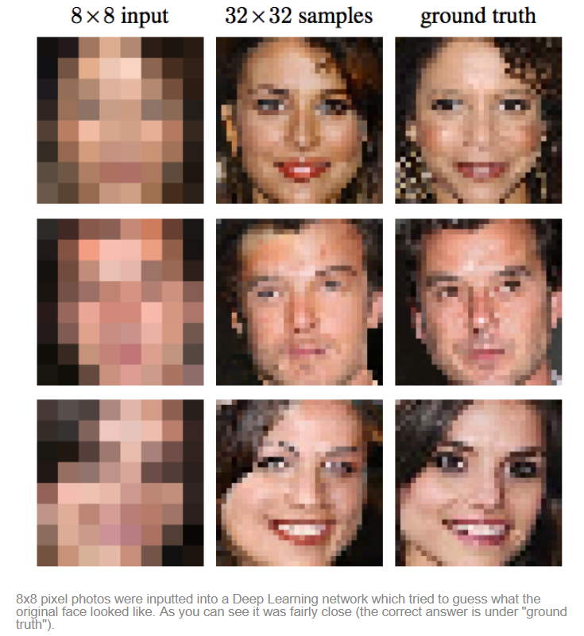
Application: Image reconstruction

Slide 30
Available Image recognition platforms
Google: https://cloud.google.com/vision/
Amazon: https://aws.amazon.com/rekognition/
Facebook: https://github.com/facebookresearch/Detectron
Microsoft: https://azure.microsoft.com/en-us/services/cognitive-services/directory/vision/
IBM: https://www.ibm.com/watson/services/visual-recognition/
https://www.kairos.com/
https://opencv.org/
https://www.faceplusplus.com/
https://www.affectiva.com/

Slide 31
Q&A

